Slide 1



SOFTWARE DEVELOPMENT PROFESSIONAL PROGRAM
Tags, Elements, and Attributes

Slide 2





Tags, Elements, and Attributes
Learning Objectives
Describe the format of an HTML document.
Name several common HTML tags, including those for links, images, and text.
Explain the differences among tags, their attributes, and their content.

Slide 3


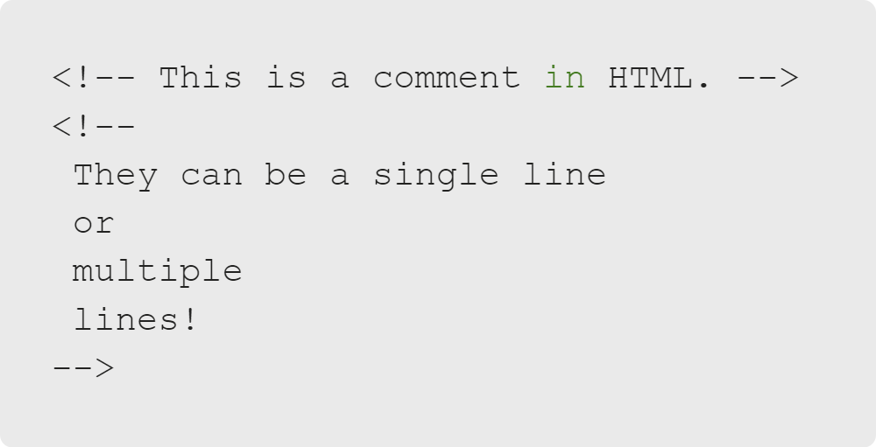
Tags, Elements, and Attributes
Comments
Let's start with comments!
Almost every language has them.
Non-executable code can also be important:
Notes to yourself
Notes to others
Explanations of complex code
Notes:
<< Exercise 1-- Comments >>

Slide 4

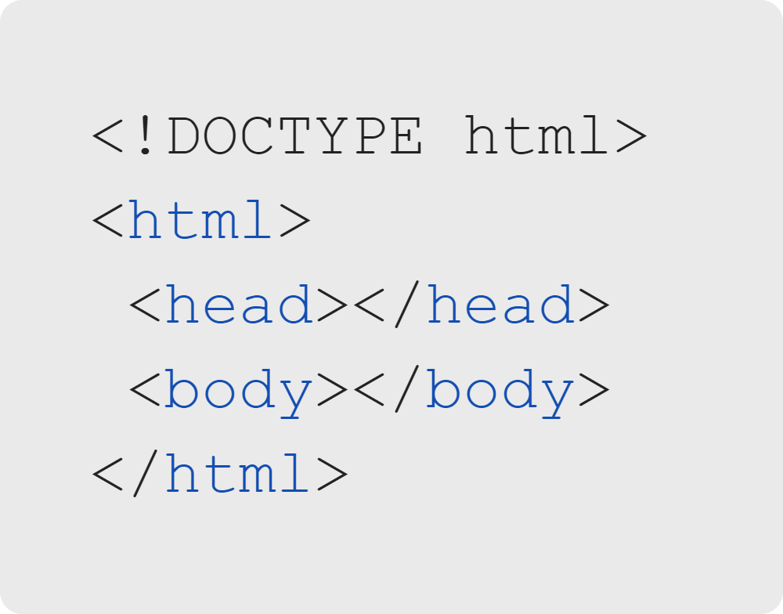
Tags, Elements, and Attributes
HTML Skeleton
An HTML outline
Also called skeleton or tree
The bare bones of an HTML doc!

Slide 5
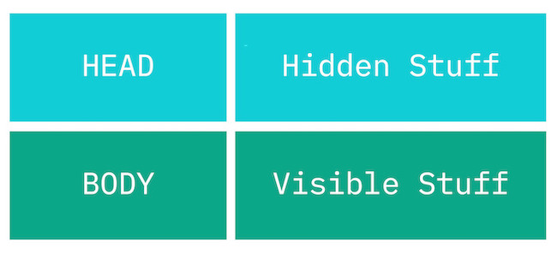
Tags, Elements, and Attributes
HTML Skeleton

Slide 6


Tags, Elements, and Attributes
HTML Skeleton
DOCTYPE: Not a tag!

Slide 7


Tags, Elements, and Attributes
HTML Skeleton
Tags: Building Blocks
Define content, meta information, or groupings

Slide 8
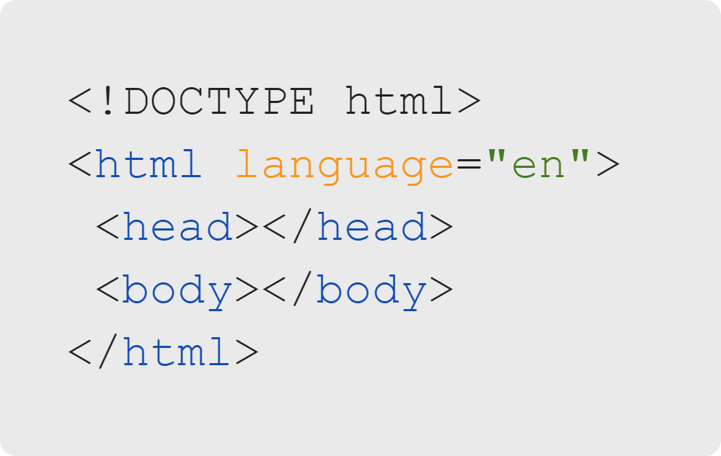
Tags, Elements, and Attributes
HTML Skeleton
The container for your page: the html tag!
The "root" of your HTML tree structure
Head section
Body section

Slide 9
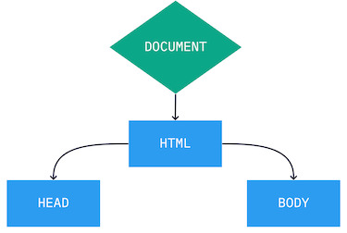
Tags, Elements, and Attributes
HTML Skeleton
Wait a second... "HTML tree"?
HTML tags live inside other tags; these are child elements.
We can visualize it as a tree.

Slide 10
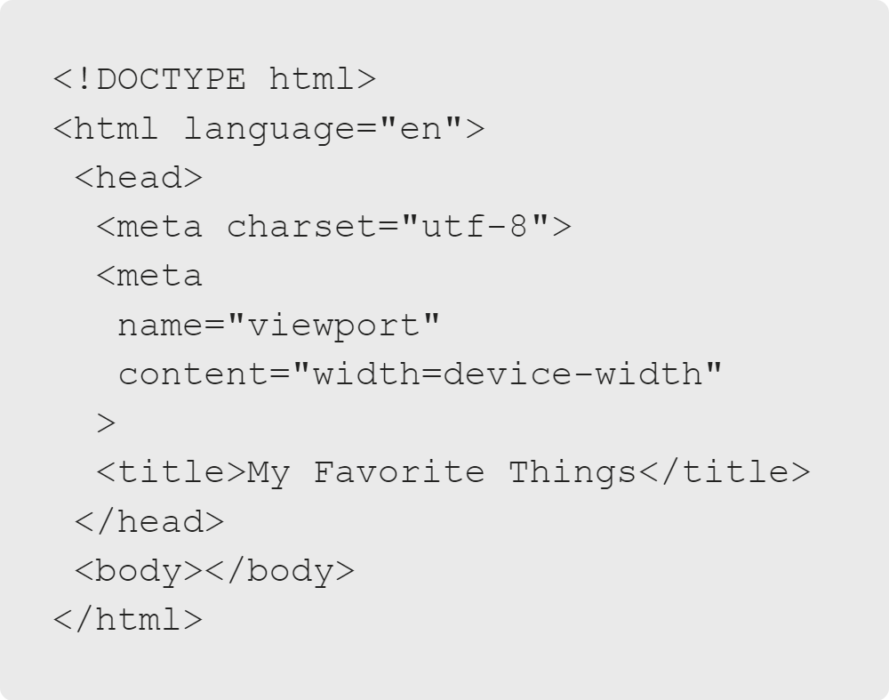
Tags, Elements, and Attributes
HTML Skeleton
What goes in the head section?
The head section contains information about the page itself.
Take a look: What is the page title?

Slide 11
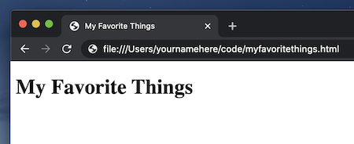
Tags, Elements, and Attributes
HTML Skeleton
The page title is "My Favorite Things."
Shows up on the tab of your browser with the favicon

Slide 12

Tags, Elements, and Attributes
Quiz: Multiple Choice
What does < meta name="viewport" content="width=device-width"> do?
A. Widens a viewable area of a projector screen
B. Negates Internet Explorer inconsistencies
C. Ensures sites use the proper width for mobile devices

Slide 13
Tags, Elements, and Attributes
Quiz: Multiple Choice Answers
🚫 Widens a viewable area of a projector screen
🚫 Negates Internet Explorer inconsistencies
✅ Ensures sites use the proper width for mobile devices

Slide 14
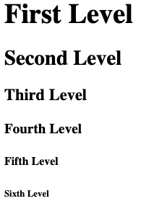
Tags, Elements, and Attributes
HTML Body
The body section of an HTML page holds the viewable content.
Headers are for important text and go from h1 (most important) to h6 (least important).
Notes:
<< Exercise 2-- Headers >>

Slide 15
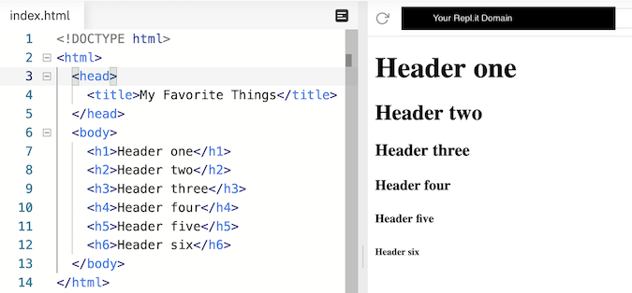
Tags, Elements, and Attributes
HTML Body

Slide 16
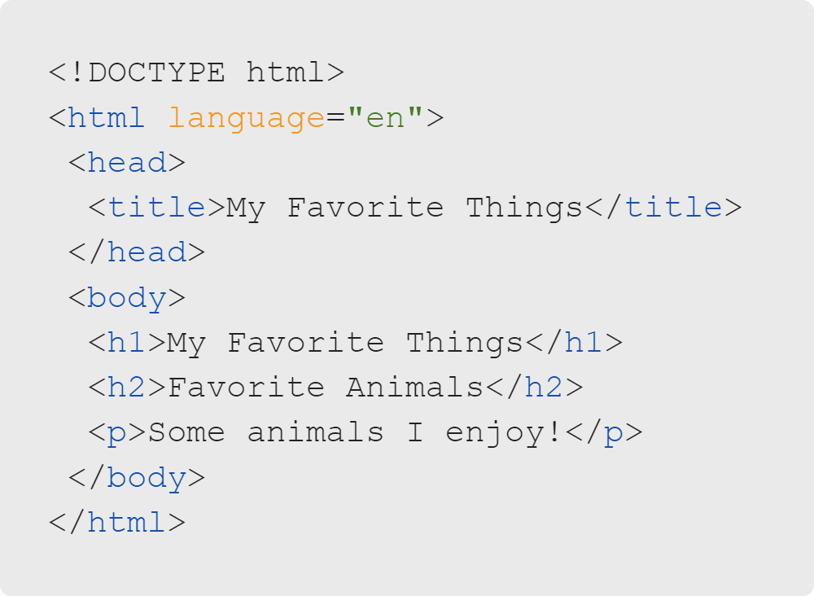
Tags, Elements, and Attributes
HTML Body
Headers reflect what your page is about in order of importance.
Paragraph tags contain text.
Notes:
<< Exercise 3-- Paragraphs >>

Slide 17
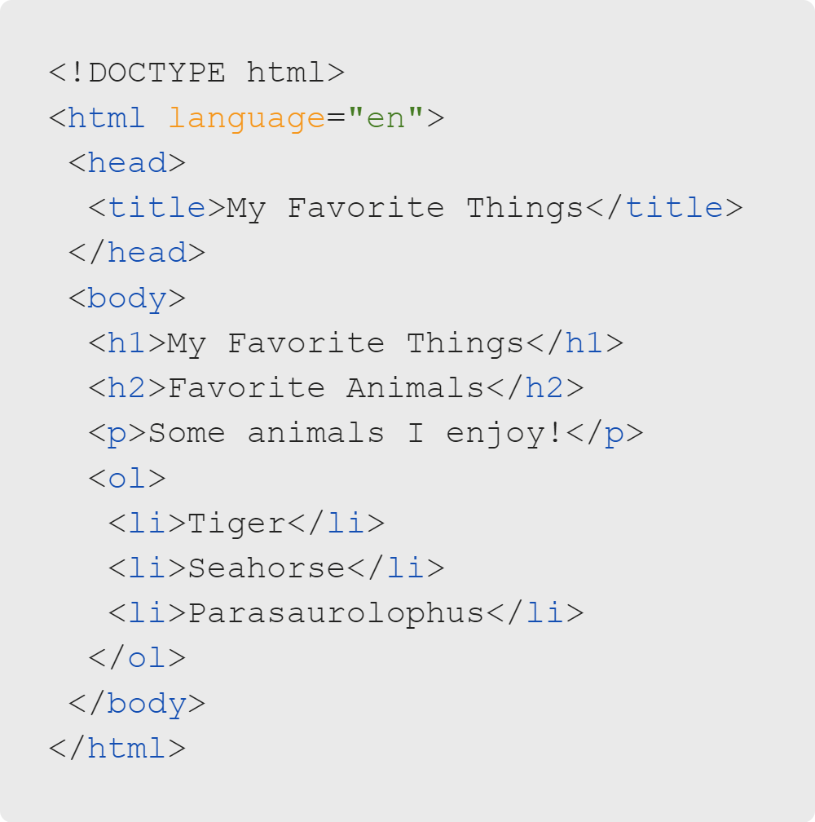
Tags, Elements, and Attributes
HTML Lists
HTML has ordered lists (ol) and unordered lists (ul).
Both types of lists contain list items (li).
Notes:
<< Exercise 4-- Lists and Children >>

Slide 18
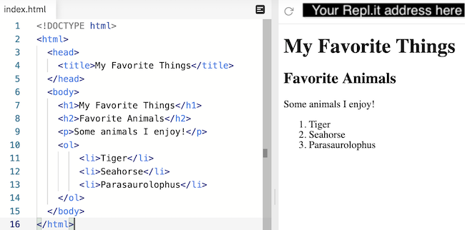
Tags, Elements, and Attributes
HTML Body

Slide 19
Tags, Elements, and Attributes
Quiz: Multiple Choice
In the favorite animals list, what happens when we change ol to ul?
A. The order is randomized (unordered list).
B. The numbers become bullet points instead.
C. The indentation is unrestricted by the size of the input.

Slide 20
Tags, Elements, and Attributes
Quiz: Multiple Choice
In the favorite animals list, what happens when we change ol to ul?
🚫 A. The order is randomized (unordered list).
✅ B. The numbers become bullet points instead.
🚫 C. The indentation is unrestricted by the size of the input.

Slide 21
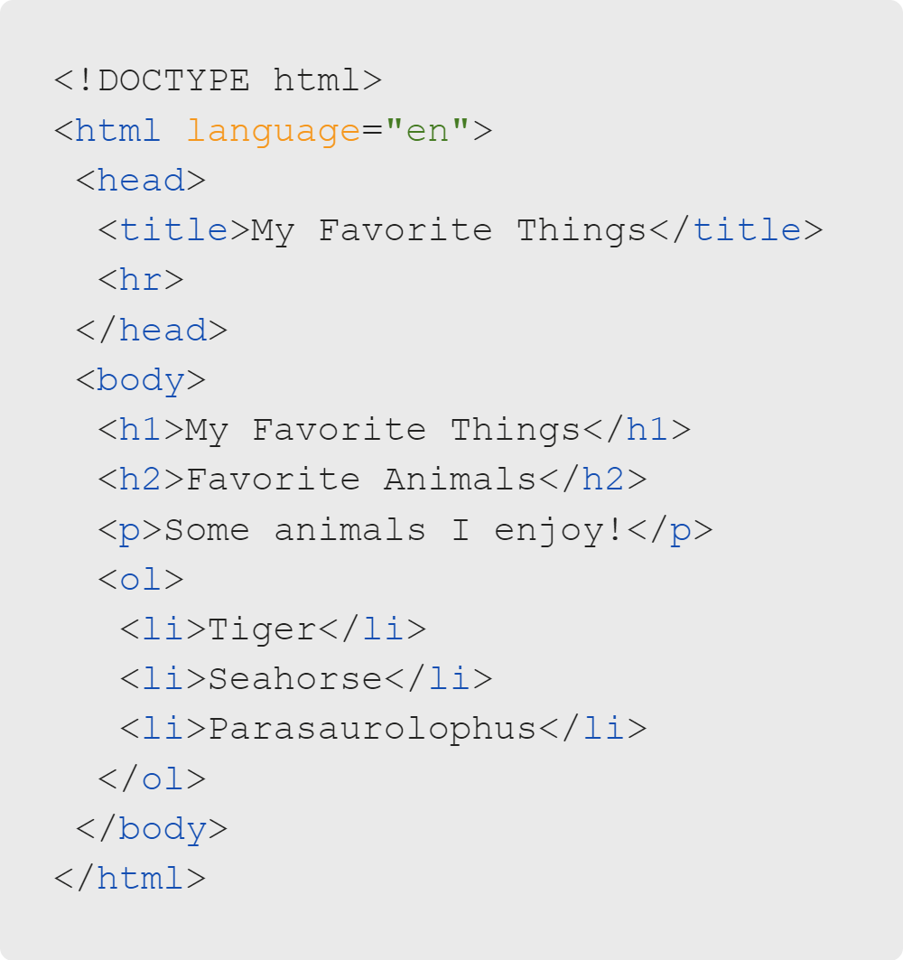
Tags, Elements, and Attributes
HTML Body
HTML has a tag (hr) that creates a horizontal rule.
This tag allows you to add a horizontal line anywhere in your document. It does not require a closing tag.
Notes:
<< Exercise 5-- Horizontal Lines >>

Slide 22
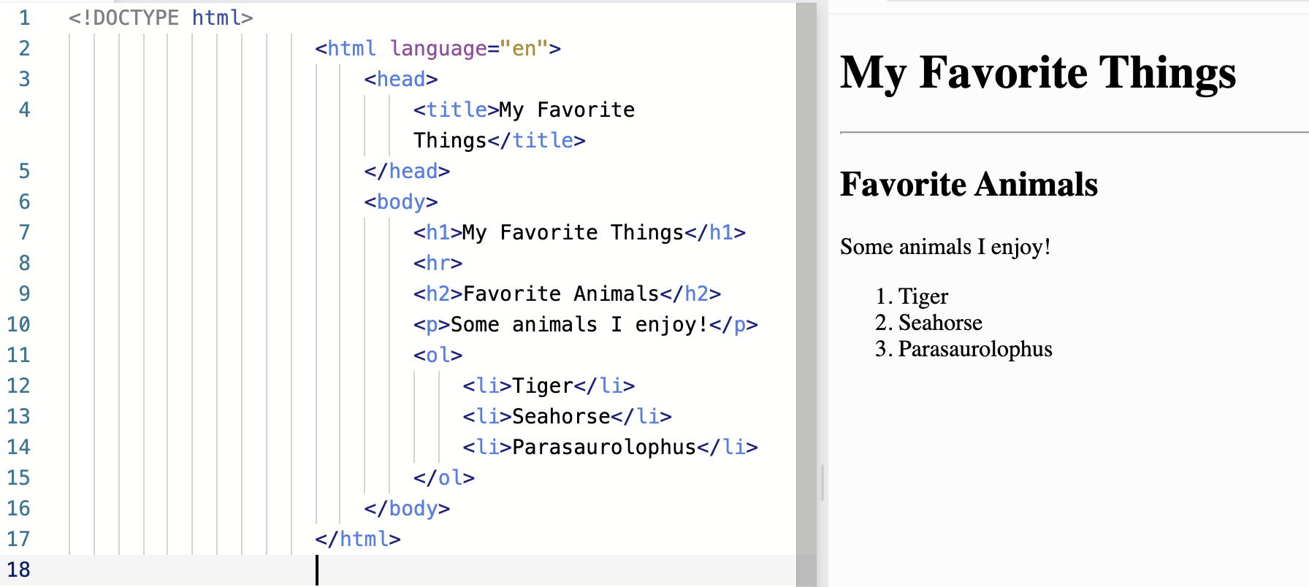
Tags, Elements, and Attributes
HTML Body

Slide 23
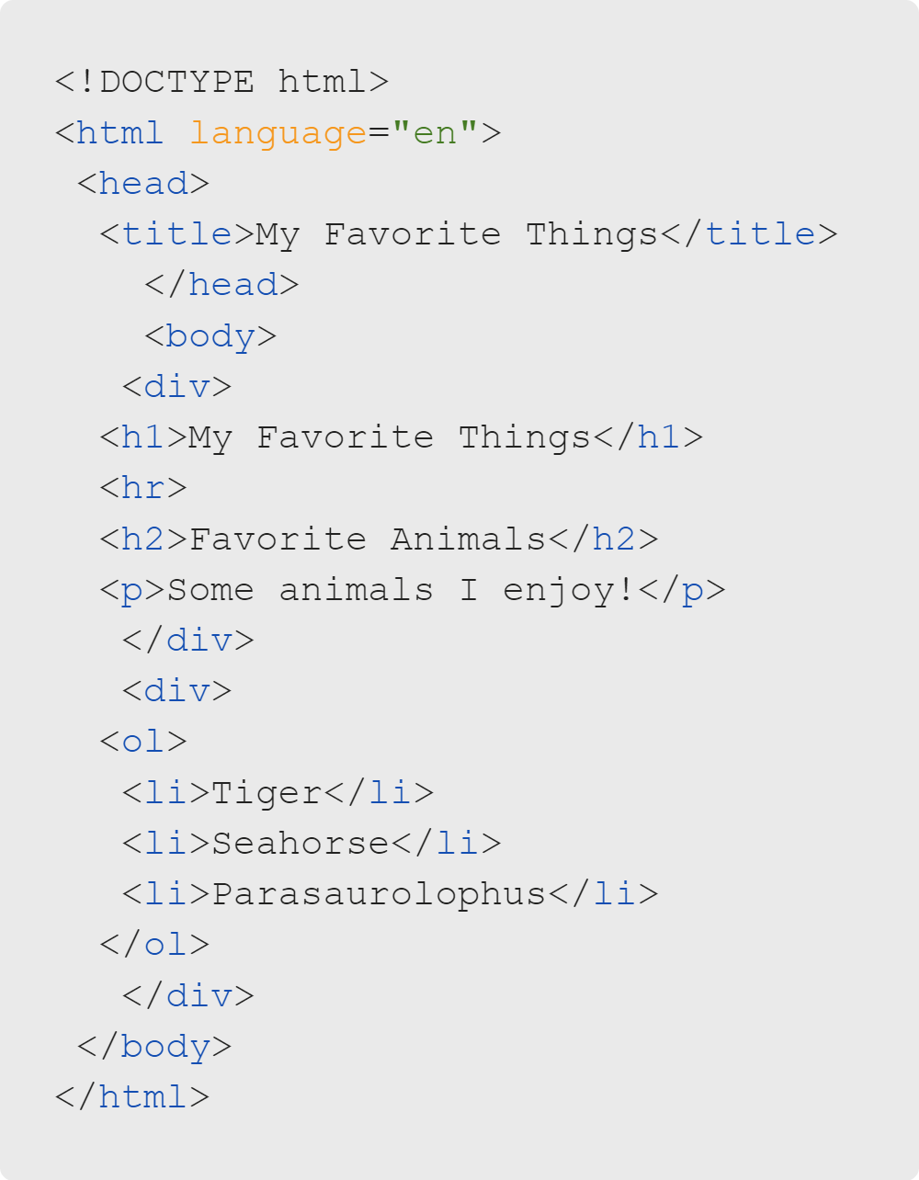
Tags, Elements, and Attributes
HTML Body
HTML has (div) tags.
This tag defines a division (section) in the HTML document.
This tag serves as a container for HTML elements. Any type of content can be placed in these tags.

Slide 24
Tags, Elements, and Attributes
HTML Attributes
Attributes provide data to HTML tags.
Remember that language attribute from earlier?

Slide 25
Tags, Elements, and Attributes
HTML Attributes
Image tags have no way of knowing which image to show...
Image tags accept two important attributes: alt and src
...unless we tell them with an attribute!

Slide 26
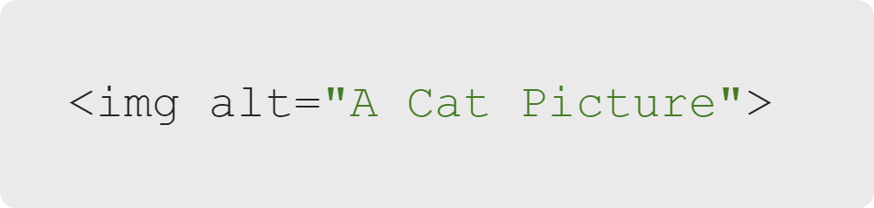
Tags, Elements, and Attributes
HTML Images
The alt attribute provides a description of the image...
...for those who can't view it.

Slide 27
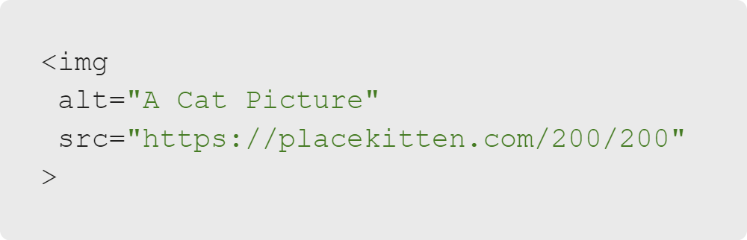
Tags, Elements, and Attributes
HTML Images
The src attribute provides a link to the image.
This can be either a path on your local machine or an online address.
Let's try out the image placeholder website PlaceKitten.
Notes:
<< Exercise 6-- Images and Attributes >>

Slide 28
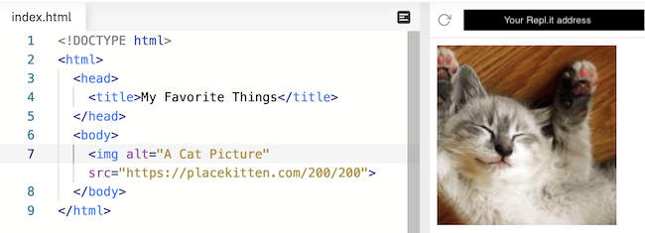
Tags, Elements, and Attributes
HTML Images

Slide 29
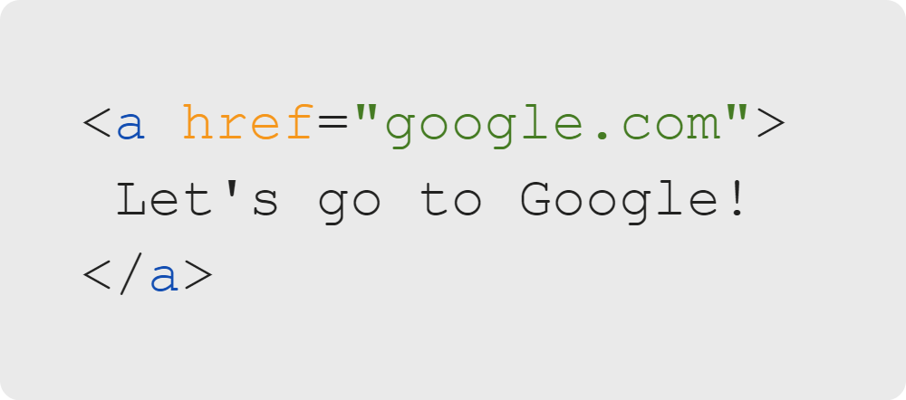
Tags, Elements, and Attributes
HTML Links
Links work similarly to images.
Links are created using the a tag, also known as the anchor tag.
The href attribute designates the link destination. The link text goes between the opening and closing tags.
Notes:
<< Exercise 7-- Links >>

Slide 30

Tags, Elements, and Attributes
Summary
What We've Covered
Tags, Elements, and Attributes
HTML comments
HTML skeleton
HTML tags
HTML attributes
Let's practice writing our own HTML.

